Slide 1
قسم الهندسة المدنية
Computers Principles
Lecture on
Microsoft Power Point
Dr. Qasim A. Aljanabi

Slide 2
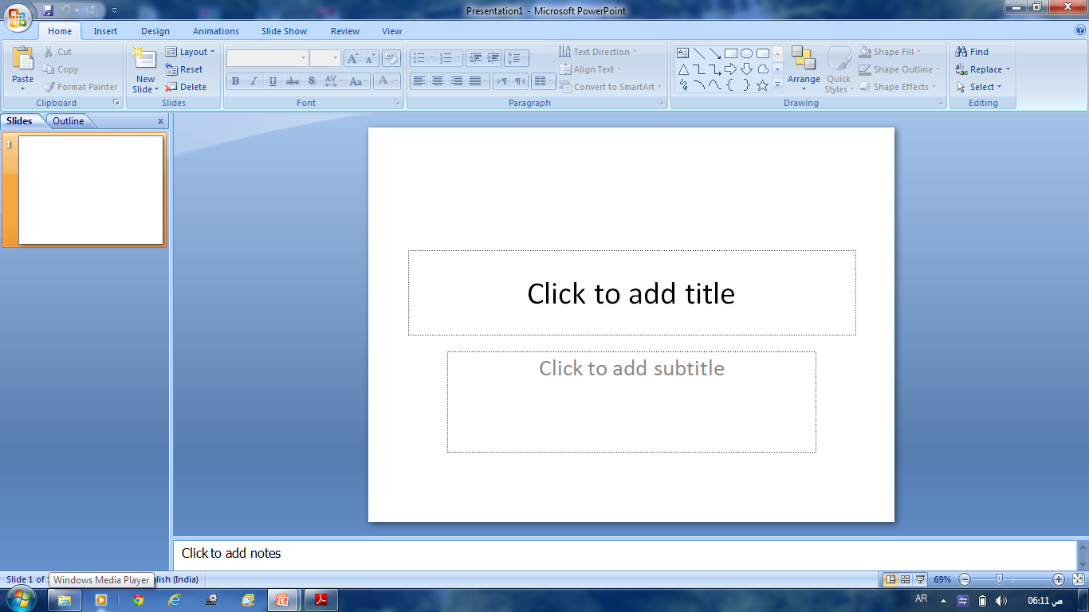
Starting
Start all programs Microsoft office Microsoft Power Point
My Computer C: Program files Microsoft Office
office 10 Microsoft Power Point
Desktop icon

Slide 3
Office Button

Slide 4
Open

Slide 5
Save As

Slide 6
Print

Slide 7
Home Commands
Clipboard : Cut, Copy, Paste, Format Painter
Slides : New, Layout, Reset, Delete
Font :
Paragraph : Text Direction, Align Text, Convert to Smart Art
Drawing : Shapes, Arrange, Quick Styles, Shape Fill, Shape
Outline, Shape Effects
Editing : Find, Replace, Select

Slide 8
Insert Commands
Table :
Illustrations : Picture, Clip Art, Shapes, Smart Art, Chart
Links : Hyperlink, Action
Text: Text Box, Header&Footer, WordArt, Date&Time, Slide No, Symbol,
Object.
Media Clips : Movie, Sound

Slide 9
Design Commands
Page Setup : Page Setup, Slide Orientation
Themes : Themes, Colors, Fonts, Effects
Background : Styles, Hide Graphics

Slide 10
Animations Commands
Preview :
Animations : Animate, Custom Animation
Transition : Style, Sound, Speed, Apply To All, Advance Slide

Slide 11
Slide Show Commands
Start Slide Show : From Beginning, From Current Slide, Custom
Set Up : Set Up, Hide Slide, Record Narration, Rehearse Timings
Monitors : Resolution

Slide 12
Review Commands
Proofing: Spelling, Research, Thesaurus, Translate, Language
Comments: Show Markup, New, Edit, Delete, Previous, Next
Monitors : Protect

Slide 13
Review Commands
Presentation Views :
Show/Hide :
Zoom :
Color/Grayscale:
Window:
Macros:

Slide 14
The End
Thank YOU

